Slide 1
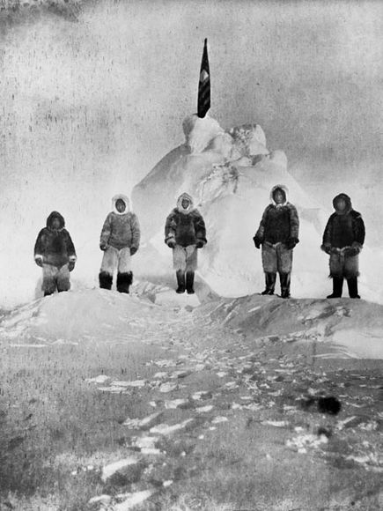
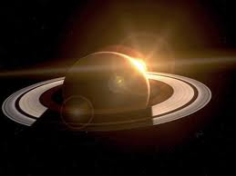
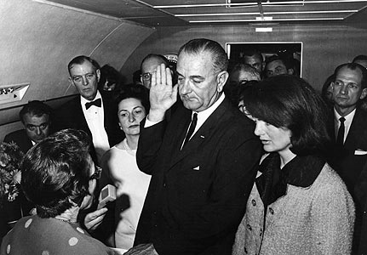
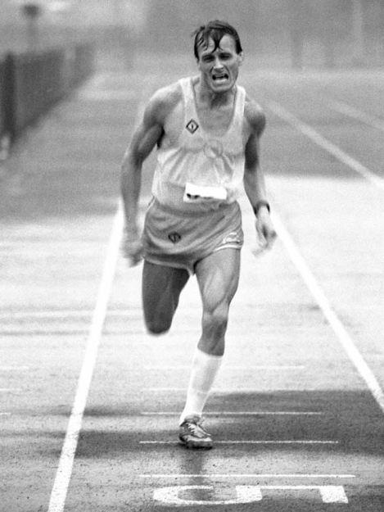
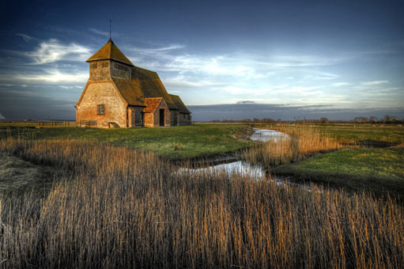
Role of Photography in Society

Slide 2
Role of Photography in Society
Photography has played a significant role in our society and continues to, especially today. If you stop to think about it, photography has perhaps even changed the path our North American society, and perhaps the world, has taken in the last one hundred and fifty years. It has the potential to tell truths that likely did not have the chance to be proven except with a photograph, it changes perceptions, it tells a story that a painting or a verbal or written account just can't.
Your assignment is to examine the role photography has had on society through art, social statement, entertainment, historical record, illustrating ideas and concepts, scientific research, and exploration.
Your task will be as follows:
You will go through this activity slide by slide and complete all tasks and jobs as they appear.

Slide 3
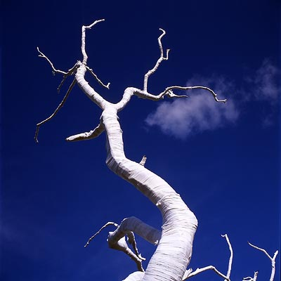
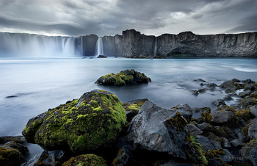
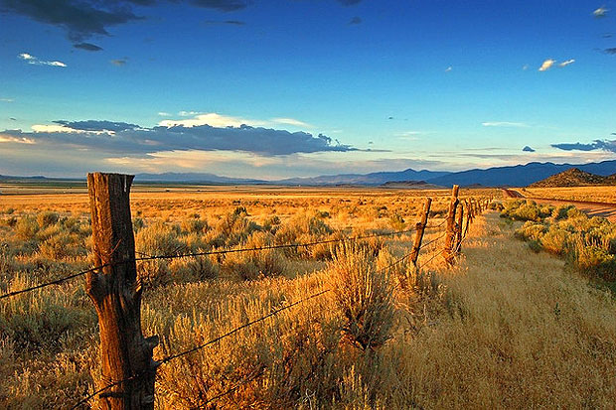
Art
Photography has been an integral part of art since its inception. In fact, the first photographers were really artists. The idea of point and shoot photography for the average person was not really popular until the 1950’s.

Slide 4
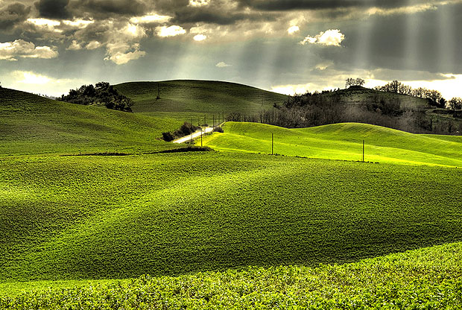
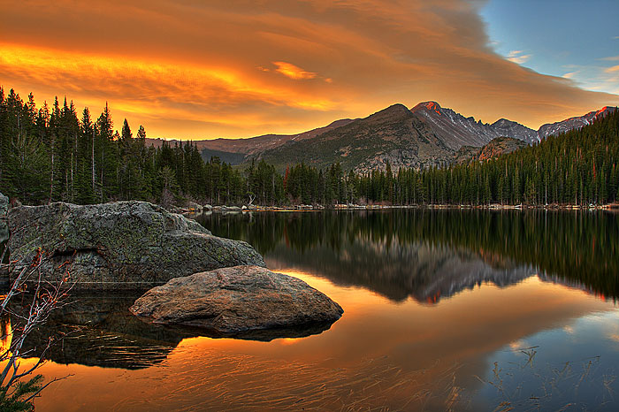
Your Task
Examine some photos on line using a search engine of your choice that you believe represent art rather than simply a point and shoot picture. Keep in mind that these shots can take hours to set up, and even more time to work on in the post-production.

Slide 5
Your Job
Please find and place four photos that you believe represent an artful approach to photography. Explain why you chose those particular photos.
Photo #1
Explain why you chose the above picture using at least two Elements and Principles of Design terms from the Visual Composition course you have previously taken.

Slide 6
Please find and place four photos that you believe represent an artful approach to photography. Explain why you chose those particular photos.
Photo #2
Explain why you chose the above picture using at least two Elements and Principles of Design terms from the Visual Composition course you have previously taken.

Slide 7
Please find and place four photos that you believe represent an artful approach to photography. Explain why you chose those particular photos.
Photo #3
Explain why you chose the above picture using at least two Elements and Principles of Design terms from the Visual Composition course you have previously taken.

Slide 8
Please find and place four photos that you believe represent an artful approach to photography. Explain why you chose those particular photos.
Photo #4
Explain why you chose the above picture using at least two Elements and Principles of Design terms from the Visual Composition course you have previously taken.

Slide 9
Social Statement
Your Task
Photography is a great form for communicating a social message. Look to the image to the right.
What is the message?
Please explain what techniques were used in creating this image so it communicates this specific and recognizable message.

Slide 10
Social Statement
What is the message?
Please explain what techniques were used in creating this image so it communicates a specific and recognizable message.

Slide 11
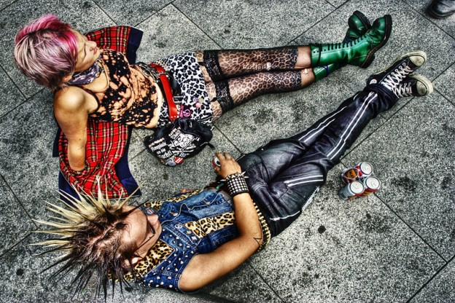
Social Statement
What is the message?
Please explain what techniques were used in creating this image so it communicates a specific and recognizable message.

Slide 12
Entertainment
Explain how the photos we use within and for our entertainment might be used to manipulate our beliefs.

Slide 13
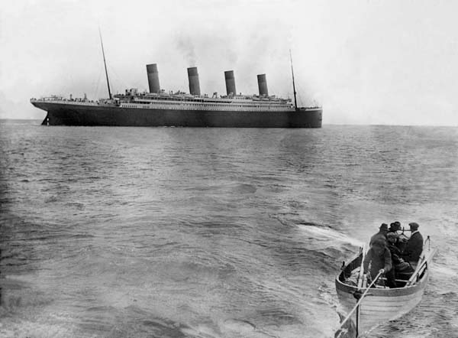
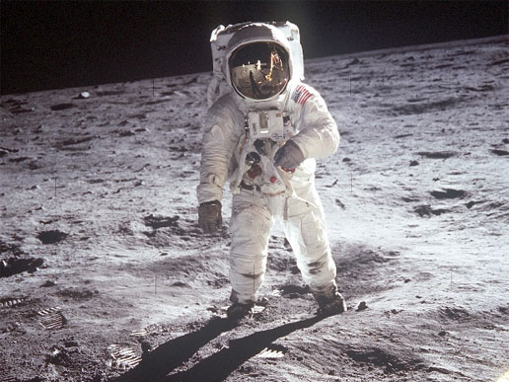
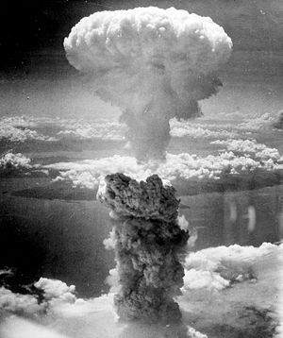
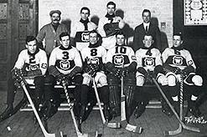
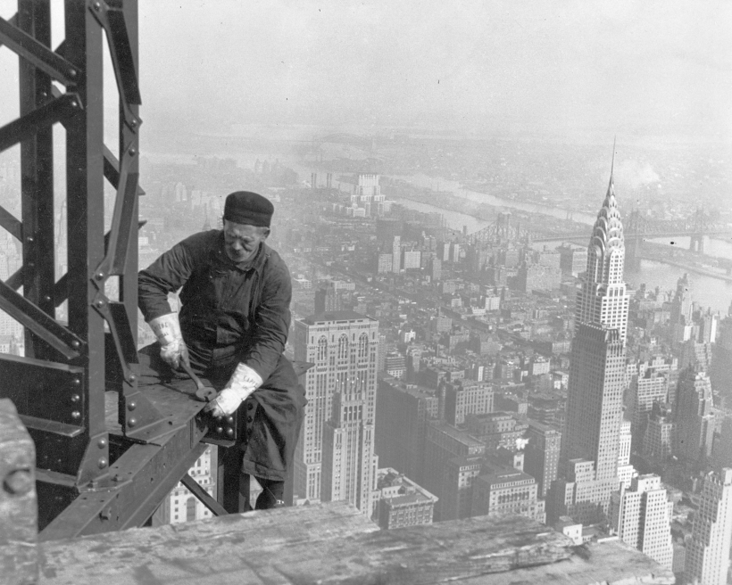
Historical Record

Slide 14
Your Job
Historical Record
Please find four images that TELL A STORY about four of the most significant historical events you can think of. Under each image explain the story that is told. Remember, the explanation you give should use only the images within that particular photograph. For instance, don’t use a picture of some German soldiers and talk about the Canadian involvement in the Second World War. The explanation should be related to the particular event, people, time, etc. in the photo.
Photo 1
Explain the story that is told within this photo.

Slide 15
Photo 2
Explain the story that is told within this photo.

Slide 16
Photo 3
Explain the story that is told within this photo.

Slide 17
Photo 4
Explain the story that is told within this photo.

Slide 18
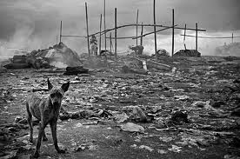
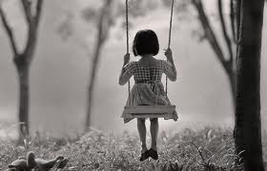
Illustrating Ideas
Photography is a very powerful way to illustrate ideas. It’s those “frozen moments of time” that can communicate so much to the viewer. Examine the photos below taking note of the wide range of emotions one could experience while viewing them.

Slide 19
Illustrating Ideas
Find some photos that illustrate one particular idea. Narrow your choice down to one and place that photo to the right and give a very specific description of the idea that is being illustrated.
Description

Slide 20
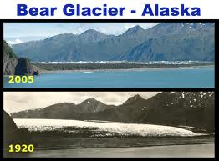
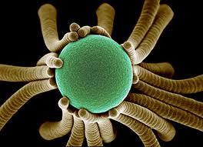
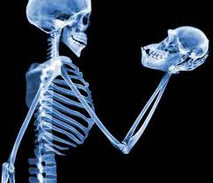
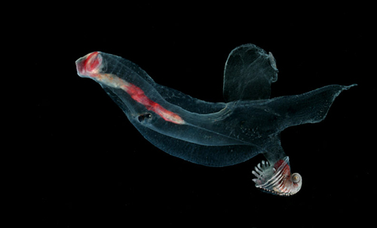
Scientific Research
In 1932, the existence of neutrons was proven using photographs, as was the existence of viruses in 1942. The planet Pluto was discovered through comparisons of photographic maps taken through telescopes. There are many other examples of discoveries, comparisons, examples, and theories proved with photography.

Slide 21
Scientific Research
Find some example photos that you believe were used for scientific research and place them here. Create a collage of pictures on this slide.

